Slide 1
GROUP-30
Dynamic Timetable System
April 4, 2021

Slide 2
Team Members
Margi Hingrajia: 201801014
Priyal Raj: 201801106
Yash Patel: 201801134
Pratik Parmar: 201801211
Harshil Goti: 201801130
Maharshi Vaghela: 201801216
Nishant Shah: 201801403
Jaydeep Machhi: 201801452
Manish Khandar: 201801222
Jaykumar Darji: 201801460

Slide 3
Problem Statement
Generally, a timetable is very difficult to set. One needs to take care about many constraints (both soft and hard) while allotting slots to batches. If the institution is large, this is one task which becomes hectic and may take many manly hours to make a perfect timetable. Our proposed project aims at making the timetable for institutions, colleges and schools a very easy task. The admin member just needs to enter the proper details of batches and the allotted faculties. Then with just a click the timetable can be generated.

Slide 4
Project objective
Build web-based Dynamic Timetable that will help in scheduling classes for an Institute.
It will change according to requirements when needed.
Allow discussion with the professor to modify lecture slot.
Further features like sending personalized Email notifications and others.

Slide 5
Technologies Used
Figma - For designing the website
HTML, CSS, Javascript - For the Frontend coding
Django - Python based framework to handle backend
SQLite - Relational database to store data
Genetic Algorithm to schedule time-table

Slide 6
Process Model Used
Iterative Waterfall Model best fitted our needs so we have used it.
Why?
It is possible to go back to the previous phase and change the requirements. So, the requirements aren’t rigid.
Easy and simple to use.
There is a room for modification.

Slide 7
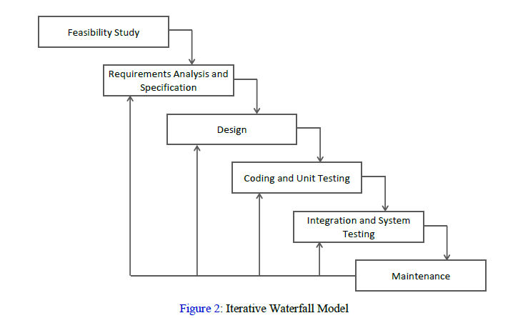
Currently Here

Slide 8
Work Done
Design and Frontend:
We have designed all the pages for the reference on Figma.
We have developed home pages(main,student,dean), login-signup and add students.
Algorithm and Backend:
We are using genetic algorithm for generating timetable. We have written pseudocode for this and are currently working on the code.
We have added most of the backend functionalities using Django like creating database,login,logout,sign up,profile,etc.
We have also generated a csv file for the database.

Slide 9
Integration of frontend and backend
User-friendly Interface for our web-application
Implementation of Algorithm for generating timetable in backend.
Increase security.
Testing functionalities
Add comment functionality
Notification using Email.
Future Work

Slide 10
Challenges Faced
The scheduling problem is NP-Hard so it was difficult to choose an efficient algorithm for our problem.
Devising an algorithm for load-balance over scheduling was challenging.
As it is an online project, requirements elicitation was difficult.
There were also some challenges while managing time.

Slide 11
Contribution
Designing Team:
Margi Hingrajia (201801014)
Priyal Raj (201801106)
Jaykumar Darji (201801460)
Pratik Parmar (201801211)
Frontend Team:
Maharshi Vaghela (201801216)
Manish Khandar (201801222)
Backend Team:
Jaydeep Machhi (201801452)
Nishant Shah (201801403)
Harshil Goti (201801130)
Yash Patel (201801134)

Slide 12
Thank you...

